Slide 1
IBM Watson Data Expert Services Learn Quick Startup Demo

Slide 2
Objectives of This Session
Upon completion of this module, you will:
Understand and Hands-on on the Quick Startup Demo.

Slide 3
Project - Create a project Data Source - Create Data Sources Assets - Add Data Sets Collaborate - Add User - Add Collaborators
Watson Studio Local Quick Startup Demo
Overview of the Quick Startup Demo

Slide 4
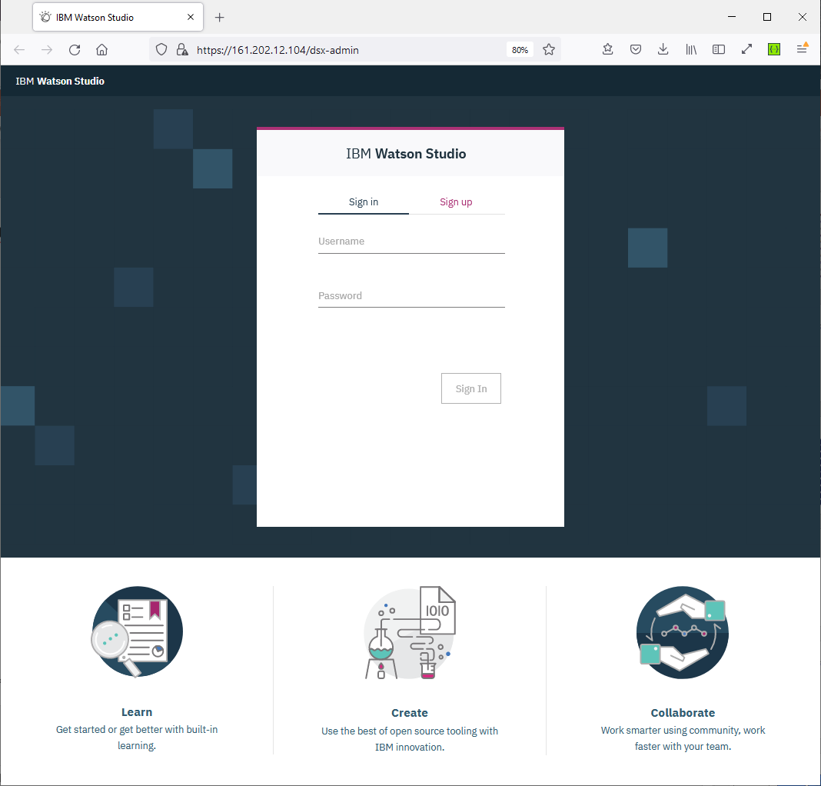
Watson Studio Local Quick Startup Demo
Welcome Page Launch
WSL url:
https://wsl-bastion.training.ibm.cloud.ims-services-2022.com/
Sign-in with a registered Username and Password
Notes:
https://161.202.12.104/dsx-admin
https://52.116.135.95/

Slide 5
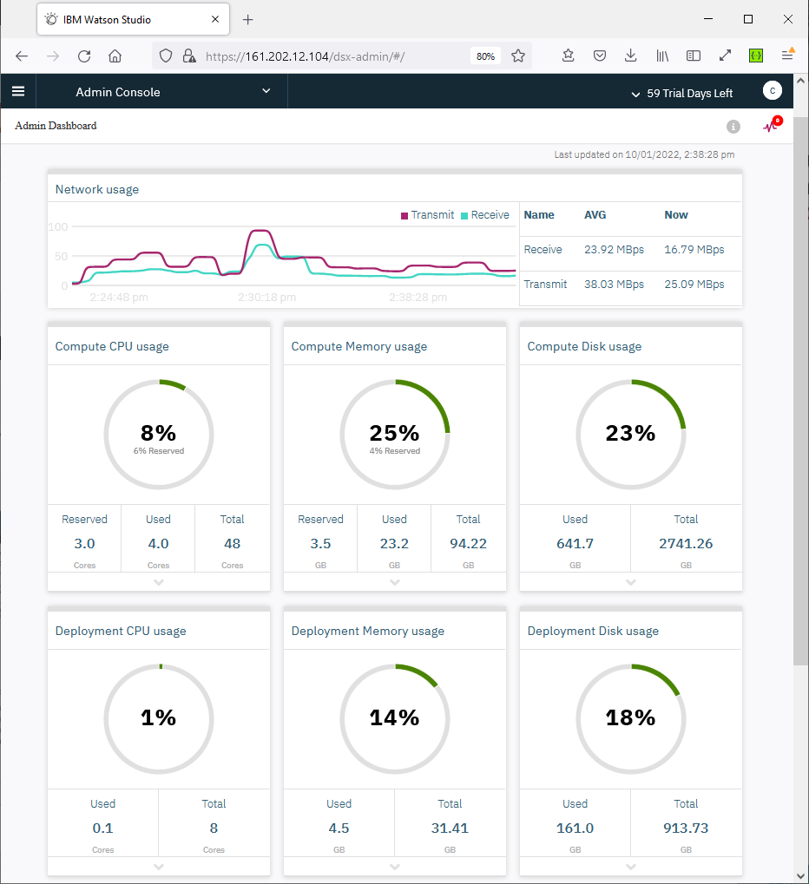
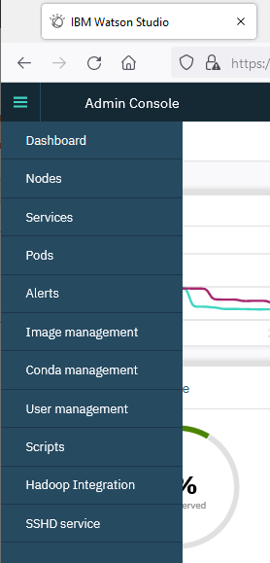
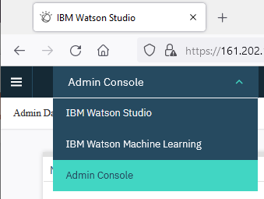
Watson Studio Local Quick Startup Demo
Signed In
View options
Hamburger icon (top menu first left)
Toggle left navigation menu.
Drop-down (top menu second left)
Switch web pages.

Slide 6
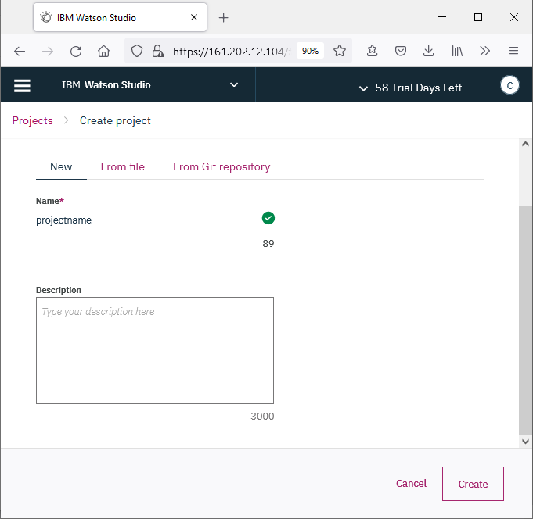
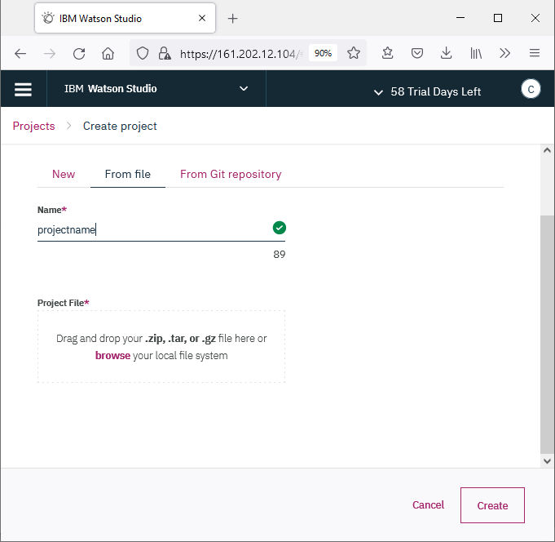
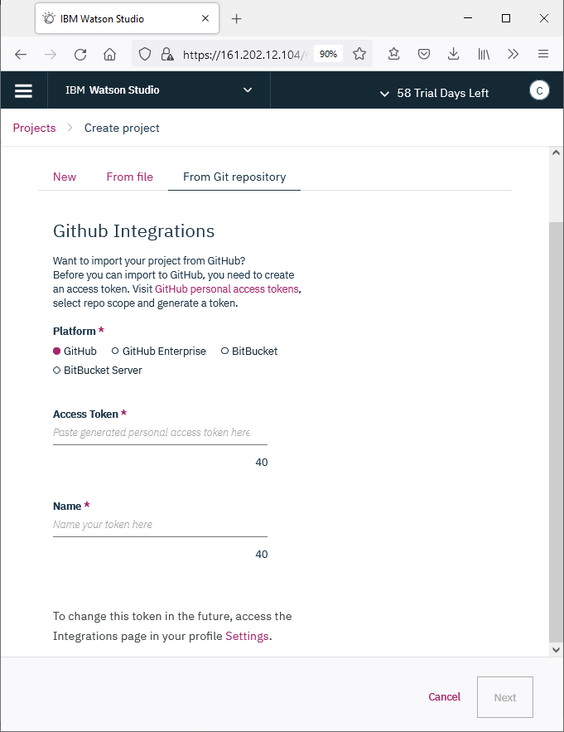
Watson Studio Local Quick Startup Demo
Create a project
From the IBM Watson Studio Home page, click Add Project
Select the type of project that you want to create (New, From File, From Git Repository)
Name the project.
Click Create.

Slide 7
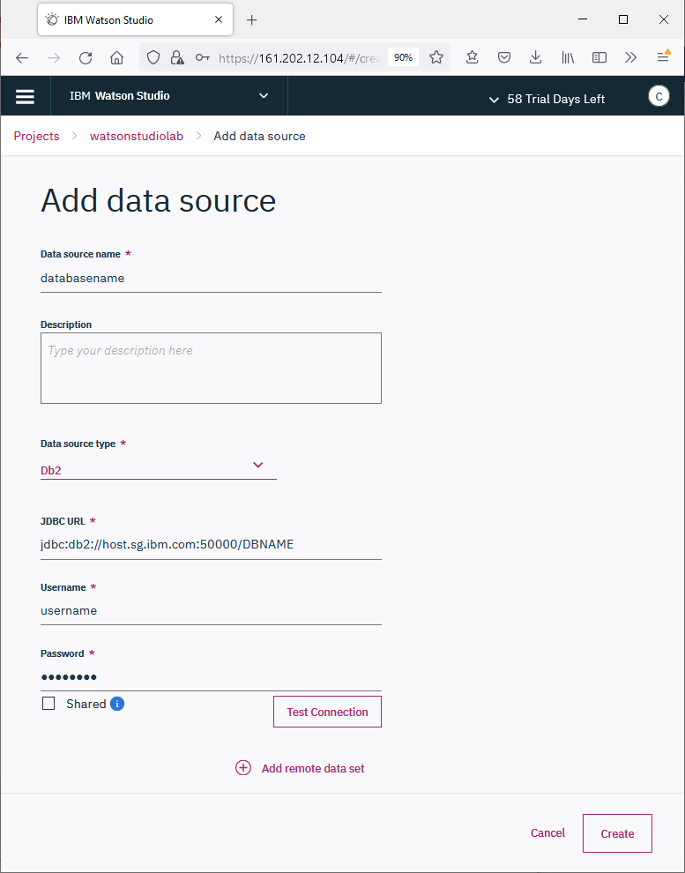
Watson Studio Local Quick Startup Demo
Create Data Sources
Navigate to the Project’s Data Sources (top menu), click Add Data Source.
Name the data source.
Select a data source type.
Create the JDBC url:
jdbc:<dbtype>://<host>:<port>/<databasename>
Enter the access credential Username and Password.
Click Test Connection to verify.
Click Create once verify it connects successful.

Slide 8
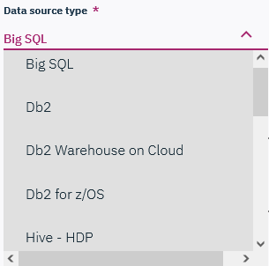
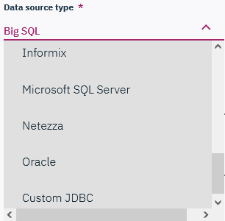
Watson Studio Local Quick Startup Demo
Create Data Sources – available types
Big SQL
Db2
Db2 Warehouse on Cloud
Db2 for z/OS
Hive – HDP
HDFS – HDP
Hive – CHD
HDFS – CHD
Hyperledger composer
Informix
Microsoft SQL Server
Netezza
Oracle
Custom JDBC

Slide 9
Watson Studio Local Quick Startup Demo
Create Data Sources Type reference
IBM Big SQL is a high performance massively parallel processing (MPP) SQL engine for Hadoop that makes querying enterprise data from across the organization an easy and secure experience.
IBM Db2 is a Relational Database Management System (RDBMS).
IBM Db2 Warehouse on Cloud is a fully-managed, elastic cloud data warehouse that delivers independent scaling of storage and compute.
Hive as data warehouse designed for managing and querying only structured data that is stored in tables.
HDFS (Hadoop Distributed File System) is a distributed file system that handles large data sets running on commodity hardware.
HDP (Hortonworks Data Platform) is an open-source framework for distributed storage and processing of large, multi-source data sets.
CDH (Customer Data Platform) is software that combines data from multiple tools to create a single centralized customer database containing data on all touch-points and interactions with your product or service.
IBM Informix is a fast and scalable database server that manages traditional relational, object-relational, and dimensional databases.
Microsoft SQL Server is a relational database management system developed by Microsoft.
IBM Netezza is an advanced data warehouse and analytics platform available both on premises and on cloud.
Oracle Database is a multi-model database management system.

Slide 10
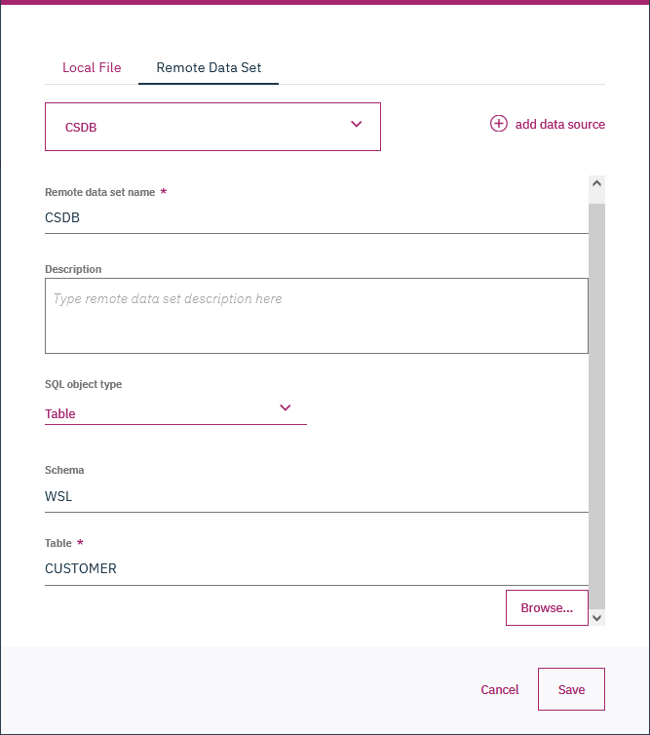
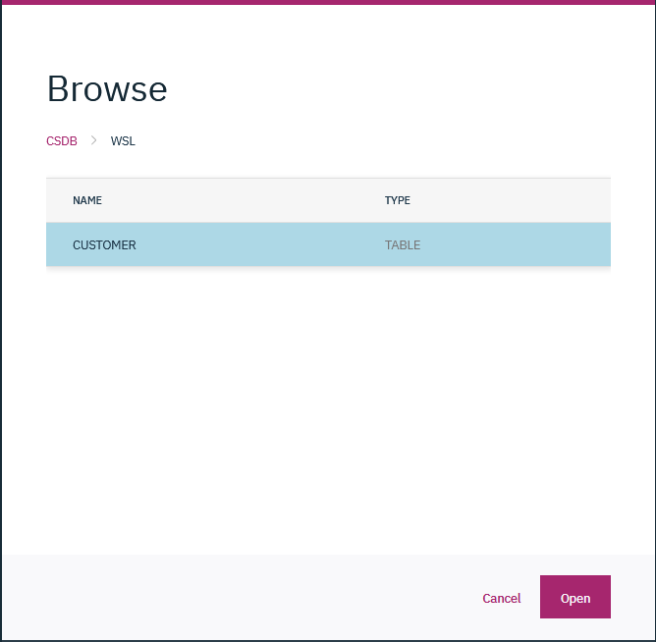
Watson Studio Local Quick Startup Demo
Add Data Sets
Navigate to the Project’s Assets (side menu), select Data sets.
Click Add Data Set.
Click Remote Data Set on pop-up.
Select a data source.
Name Remote data set name.
Select default Table as the SQL object type.
Click the Browse.., select required Table and click Open.
Click Save to complete.

Slide 11
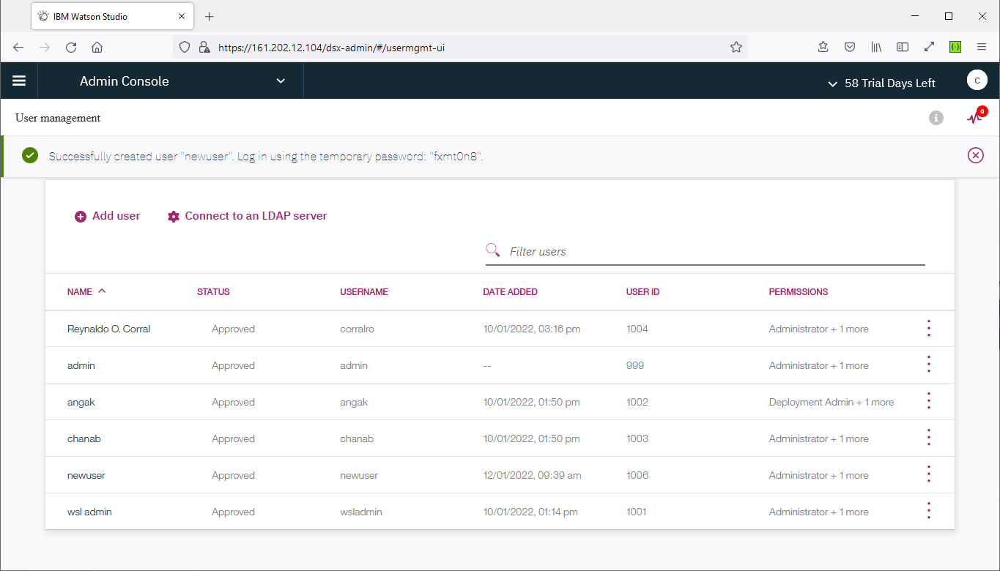
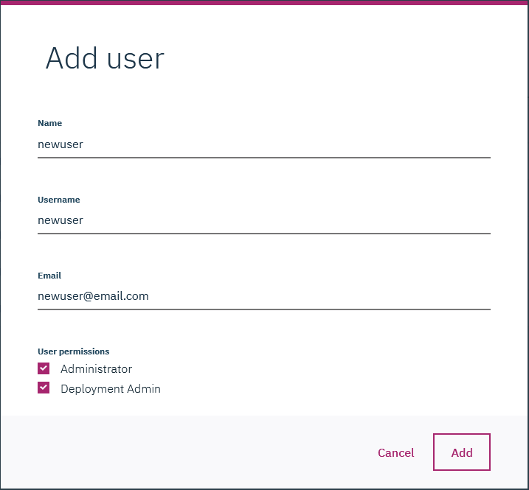
Watson Studio Local Quick Startup Demo
Add User
From the Admin Console page, click User Management (side menu).
Click Add User, provide a Name, Username and Email.
Check the required User permissions.
Click Add to complete.
Password will be generated.

Slide 12
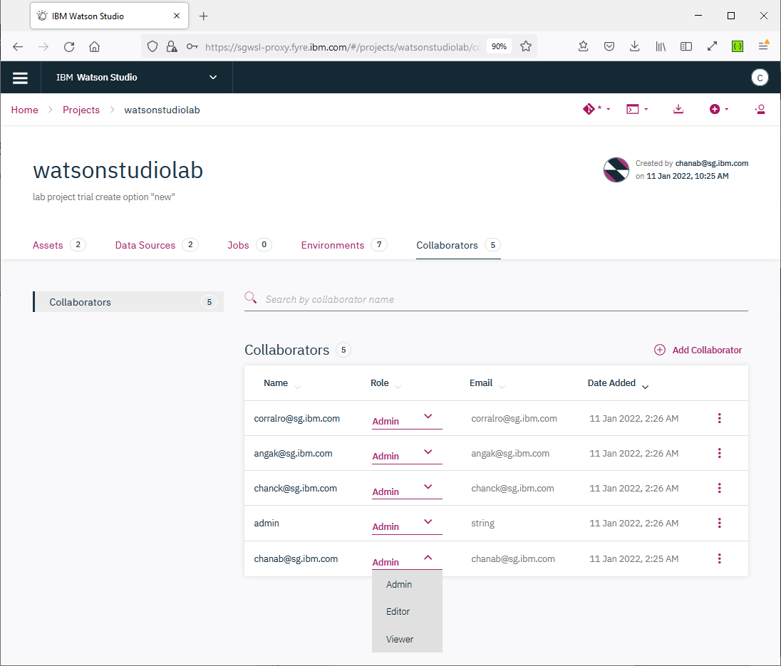
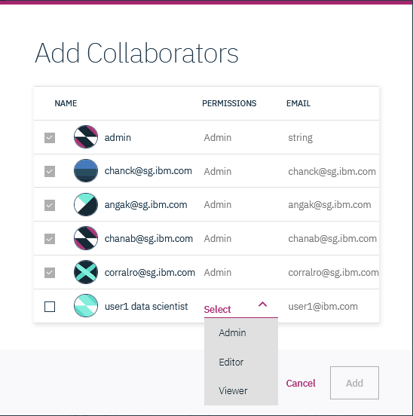
Watson Studio Local Quick Startup Demo
Add Collaborators
Prerequisites: User account added.
From the Project’s Collaborators (top menu), click Add Data Set.
Click Add Collaborator.
Check any user as necessary and select the permissions role.
Click Add to complete.

Slide 13
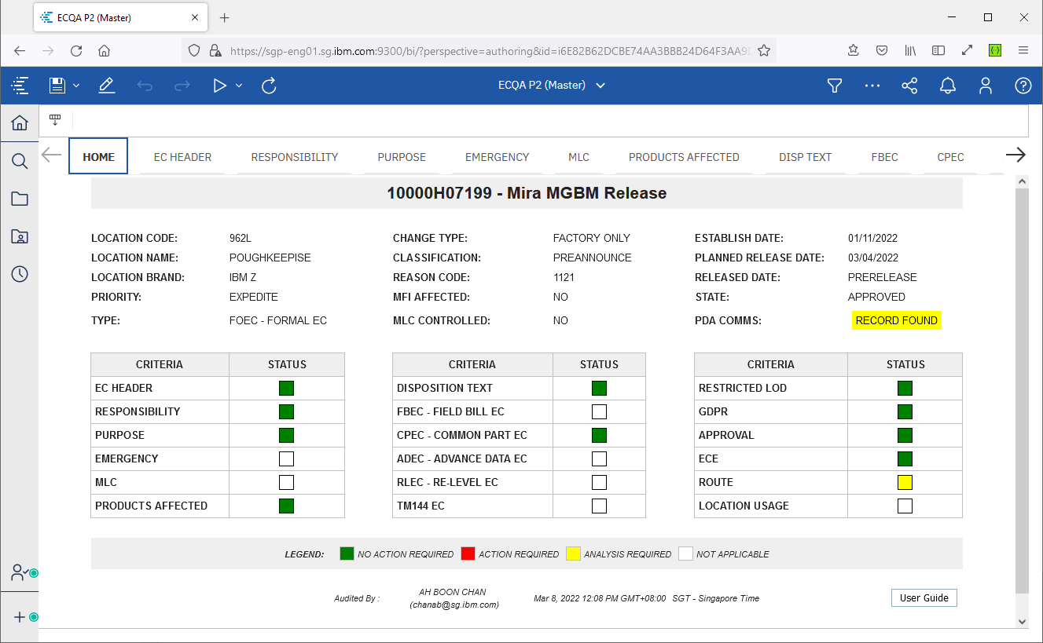
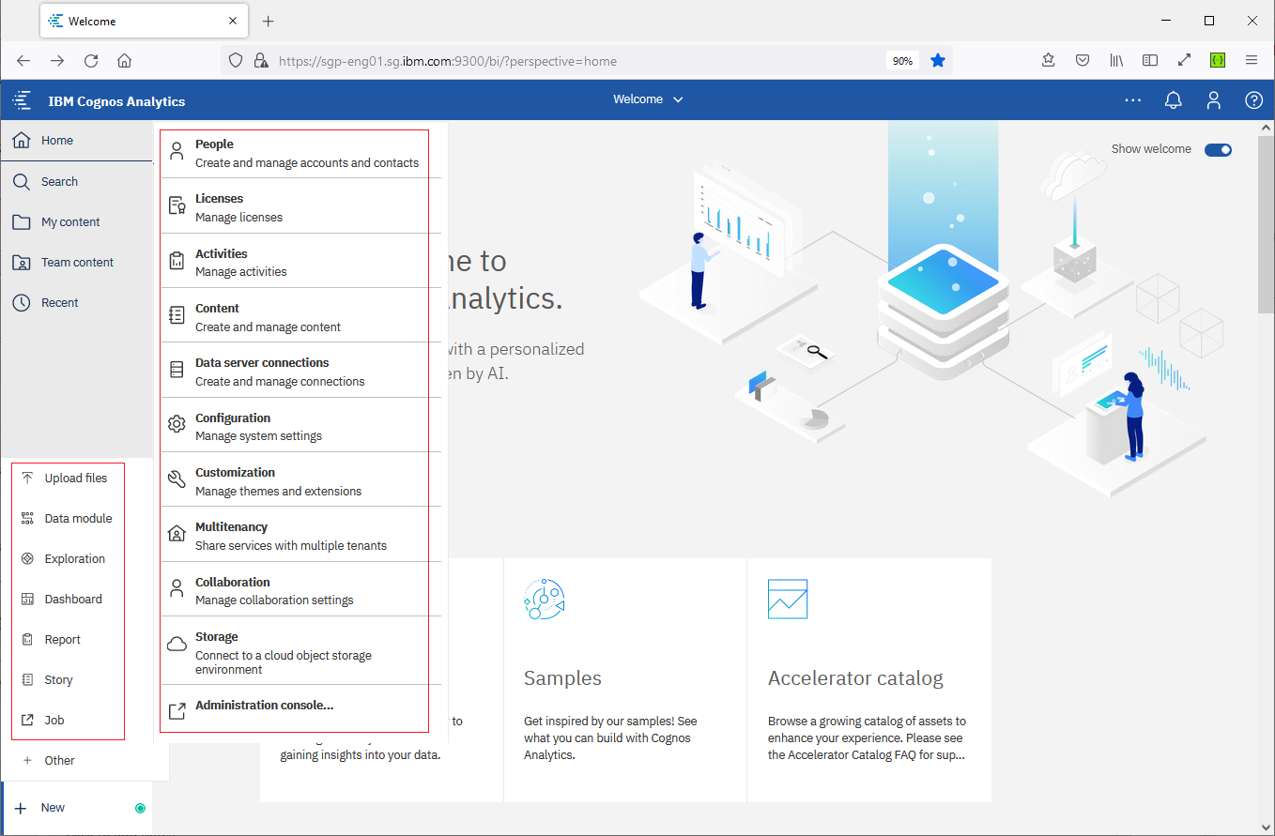
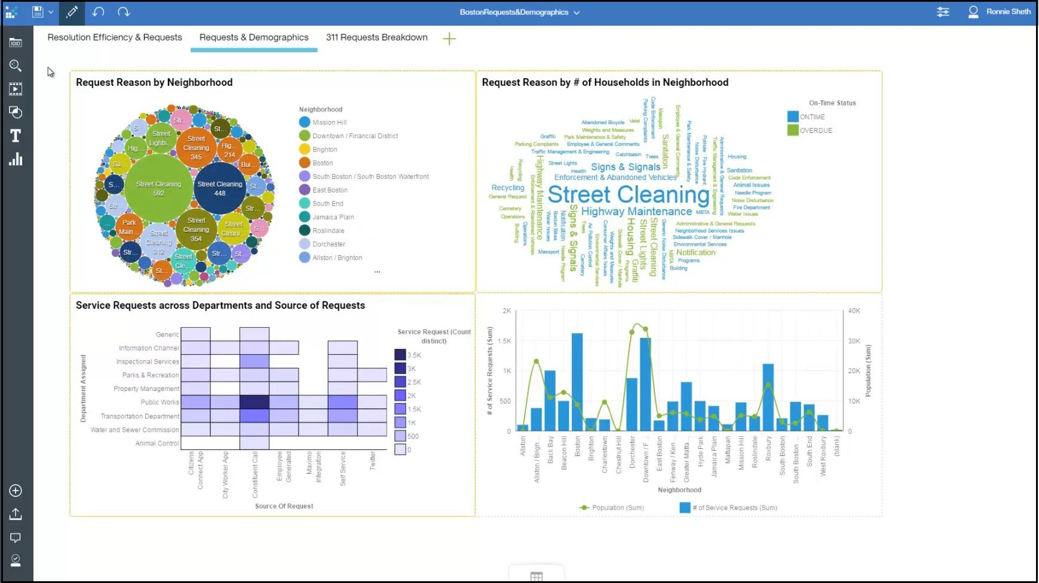
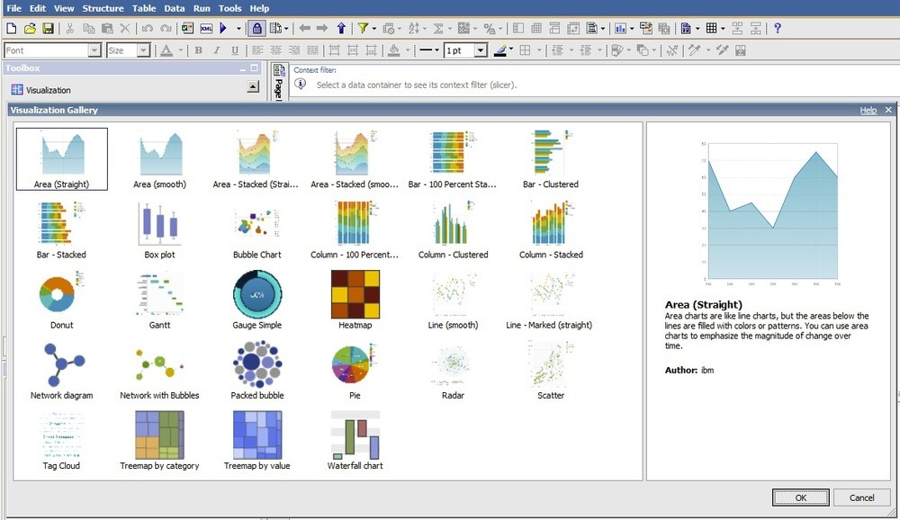
Watson Studio Local Cognos Report Get-to-know

Slide 14
IBM Watson AI / Watson & Cloud Platform Expert Services / © IBM Corporation

Slide 15
Q&A
IBM Watson AI / Watson & Cloud Platform Expert Services / © IBM Corporation

Slide 16
BACKUP
IBM Watson AI / Watson & Cloud Platform Expert Services / © IBM Corporation

Slide 17
To create an RSA-4096 key:
ssh-keygen -t rsa -b 4096
To create Ed25519 key:
ssh-keygen -t ed25519 -C "your@email.address"
To Connect to WSL:
ssh -p 31000 1001@wsl-bastion.training.ibm.cloud.ims-services-2022.com

